Slide 1
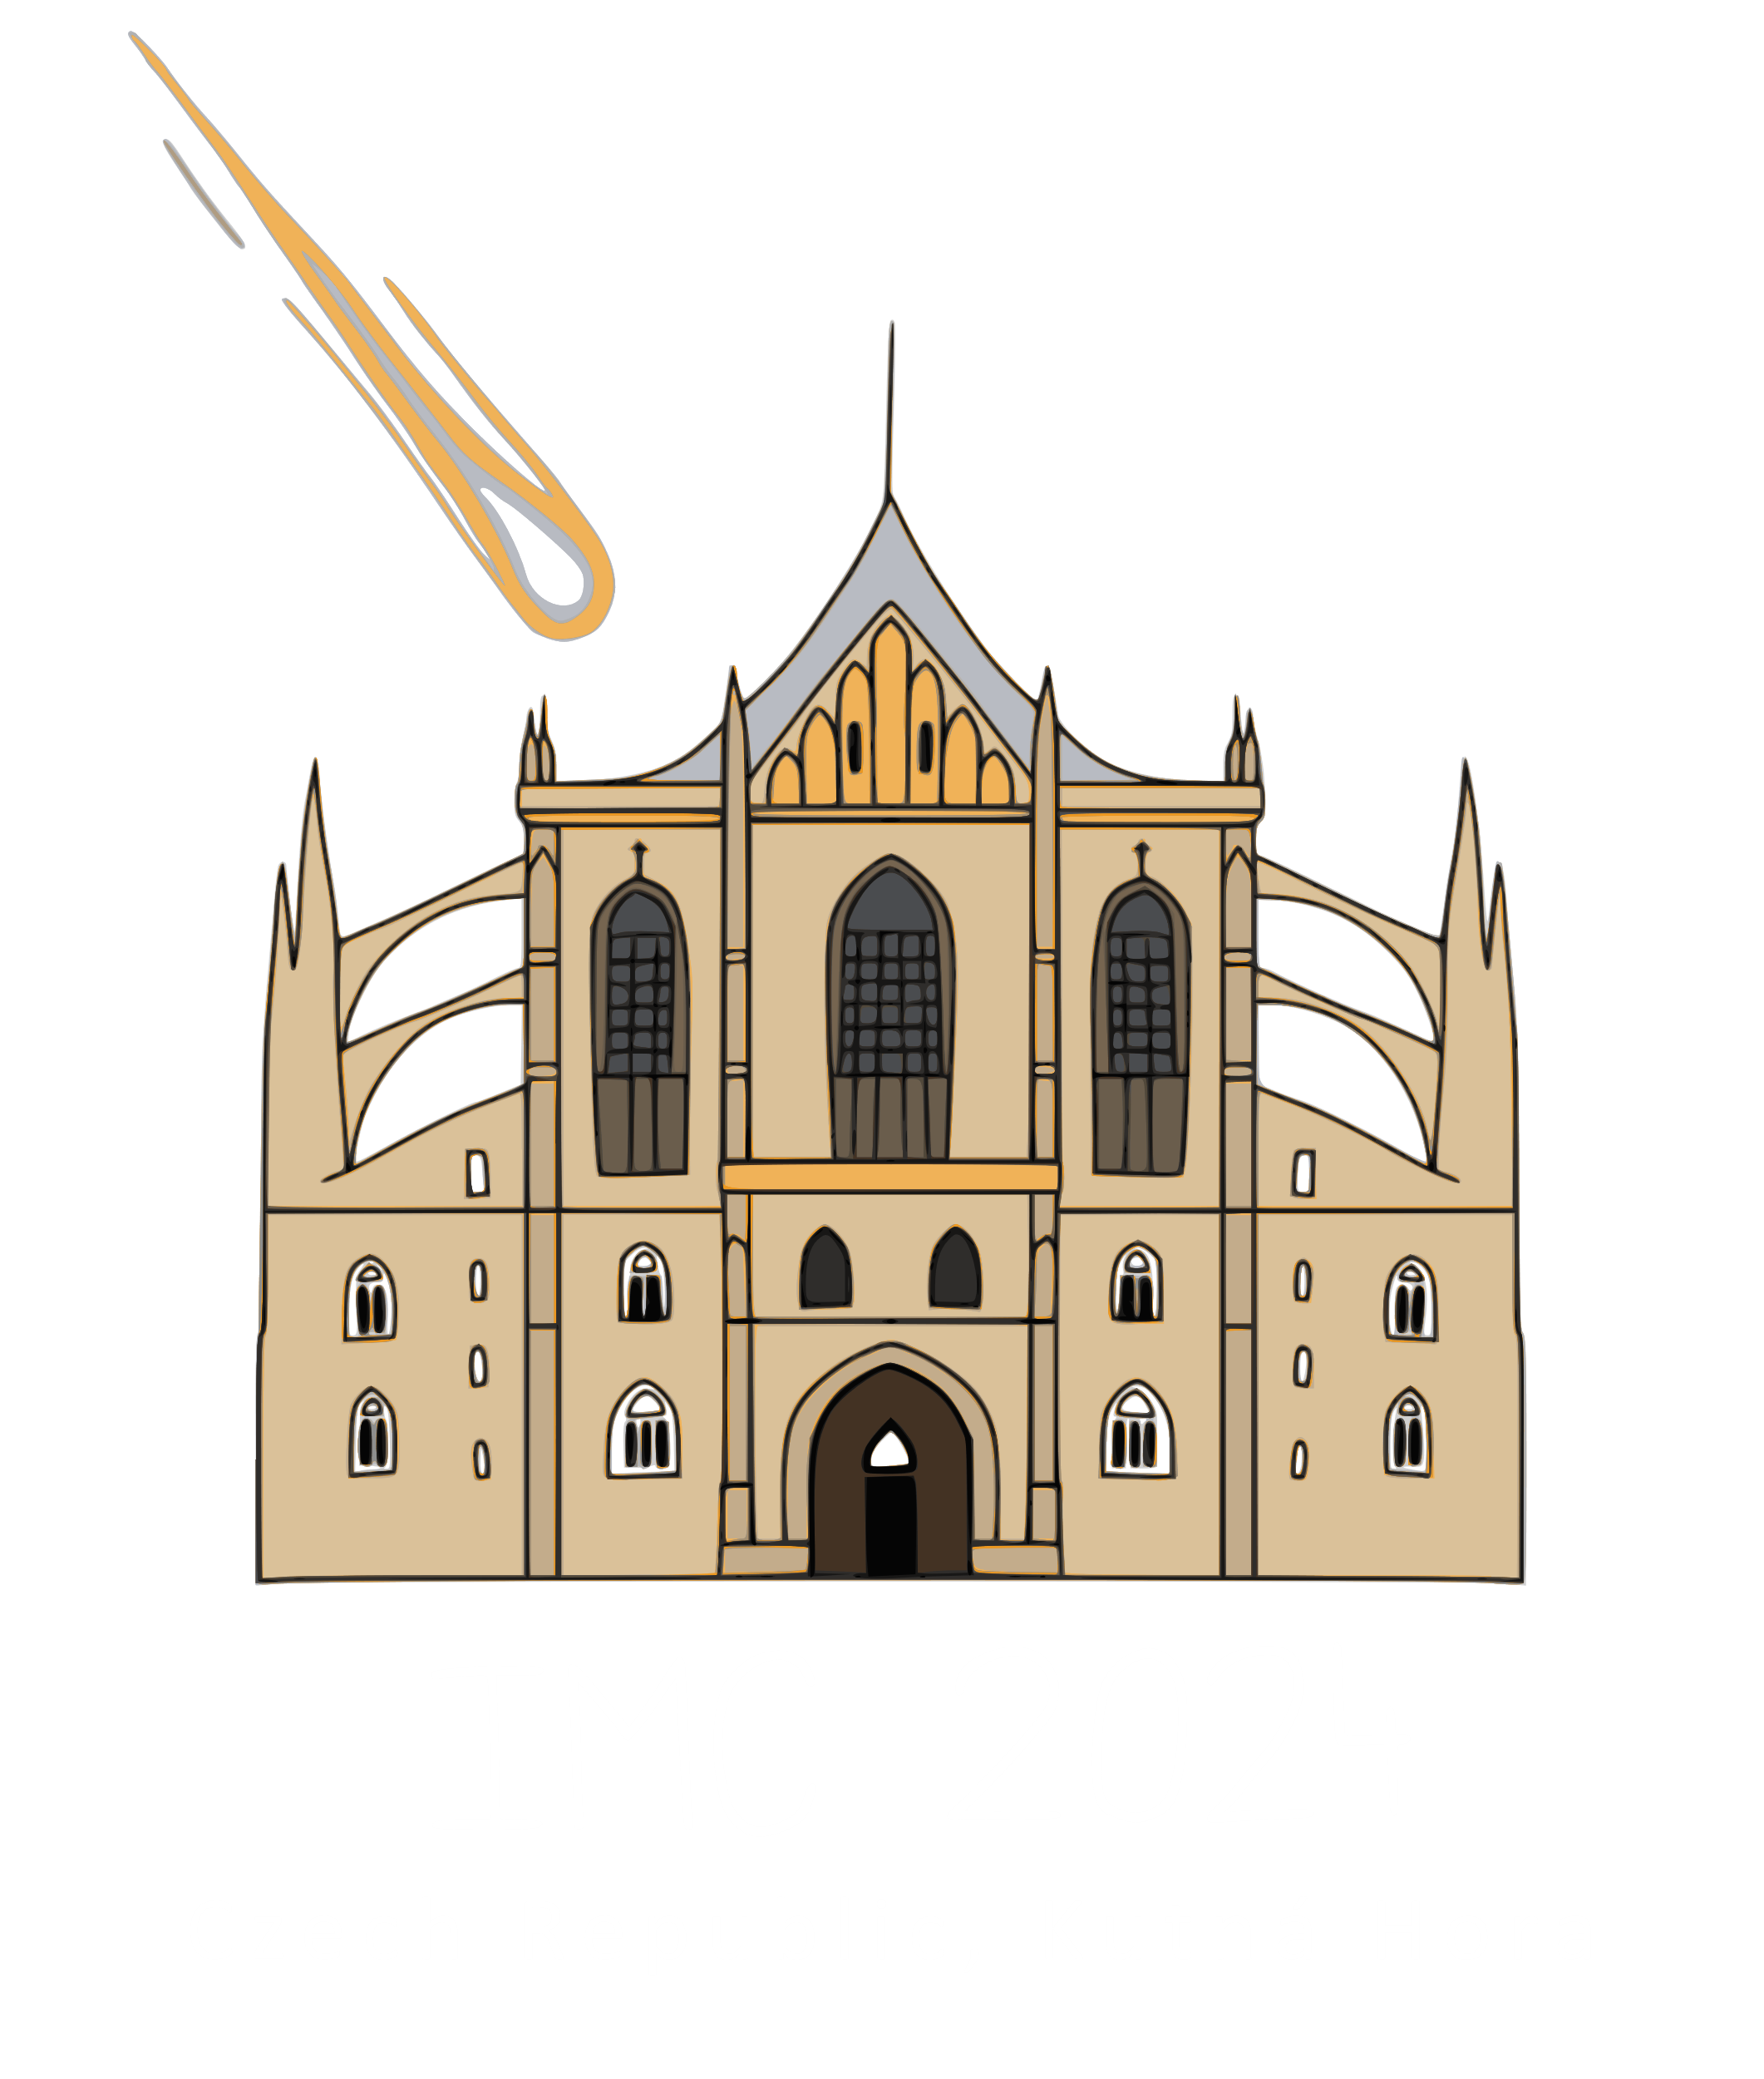
Moving sources in moving media: Tracing 2024 BX₁
through Earth’s atmosphere with seismoacoustic data
Dario Eickhoff, Jan-Phillip Föst & Joachim Ritter
© Tobias Felber., https://fireball.imo.net/members/imo_photo/view_photo?photo_id=16279

Slide 2
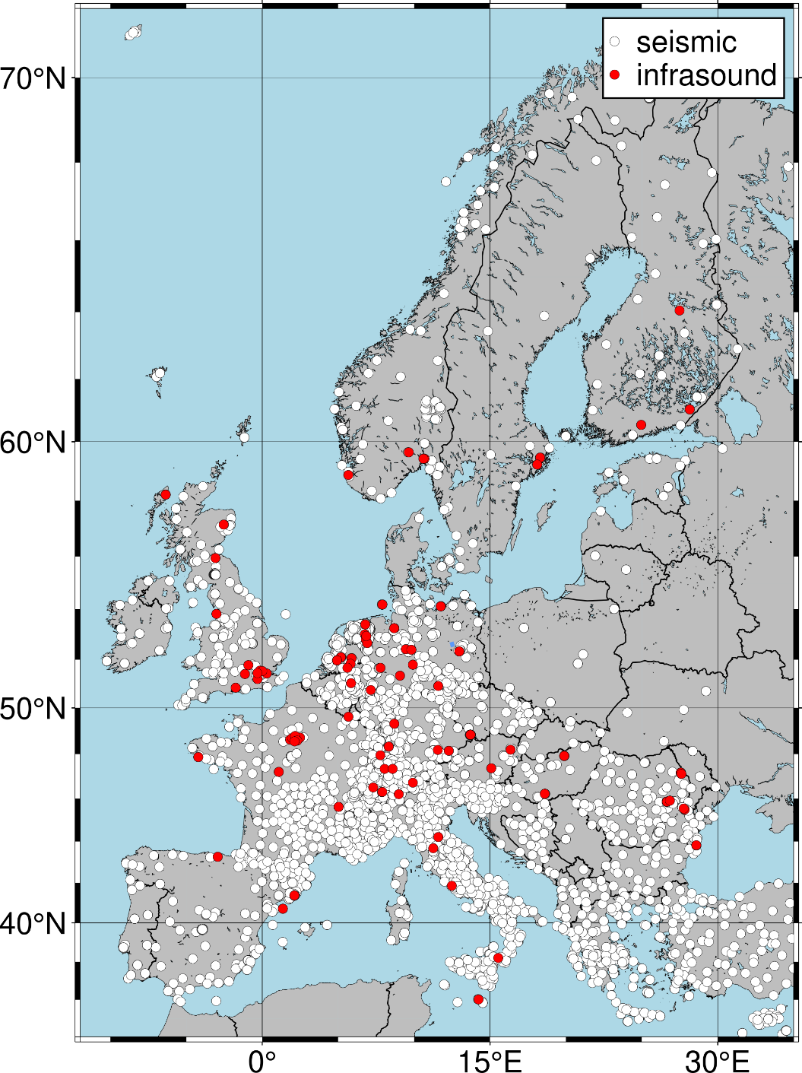
Why use seismoacoustic data?
1000s of seismoacoustic stations around the globe
data is openly available
closure of spatial observation gaps
Permanent recording of seismoacoustic stations
closure of temporal observation gaps
Acoustic waves produced by meteoroids dissipate slowly
2

Slide 3
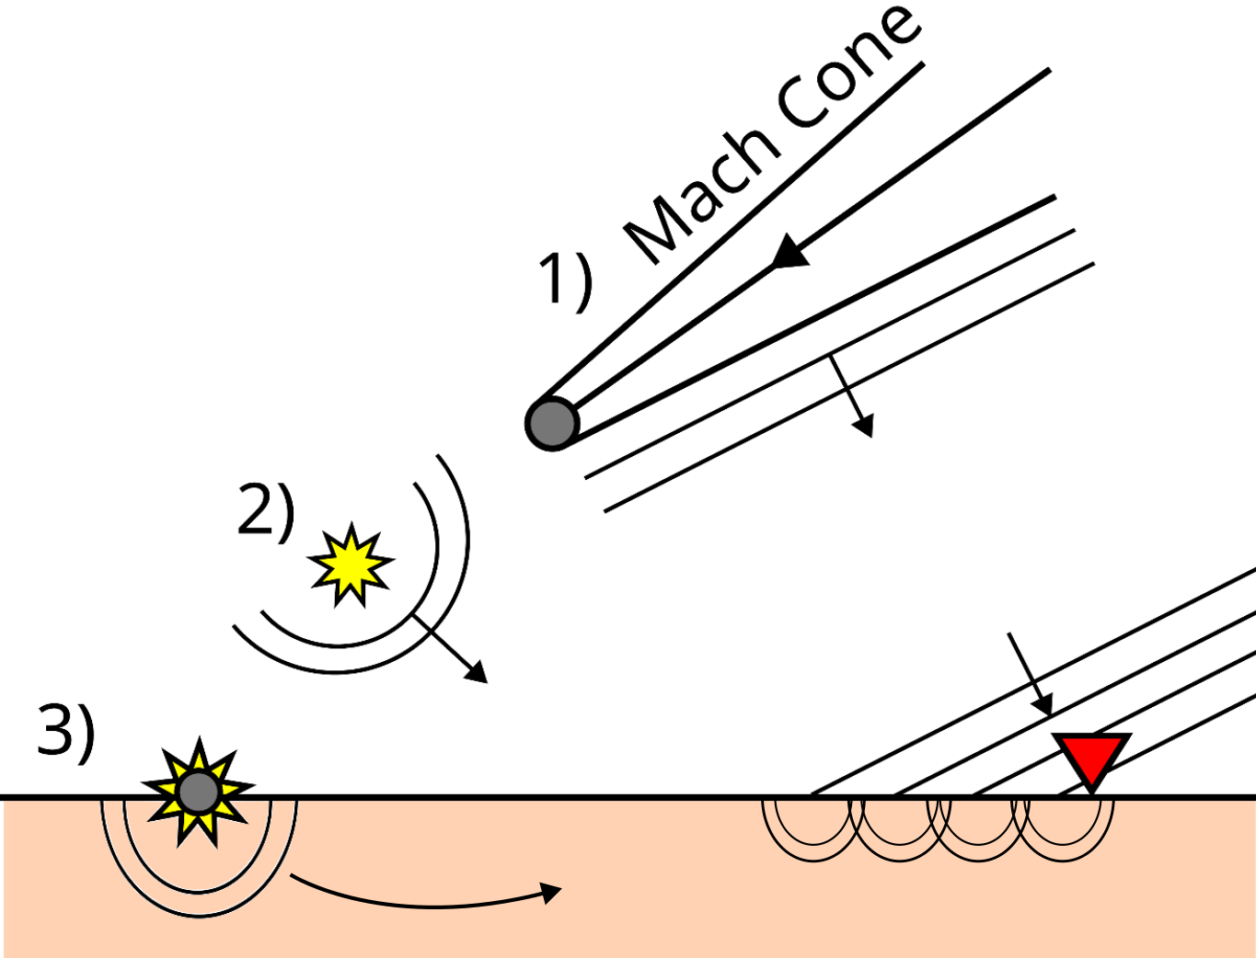
What signals can be detected?
1) supersonic flight through atmosphere:
Mach Cone, line source
acoustic wave and induced seismic wave
2) explosion/fragmentation event
point source
acoustic wave and induced seismic wave
3) impact event
point source
seismic wave generation
Figure modified after Edwards et al., 2008
3

Slide 4
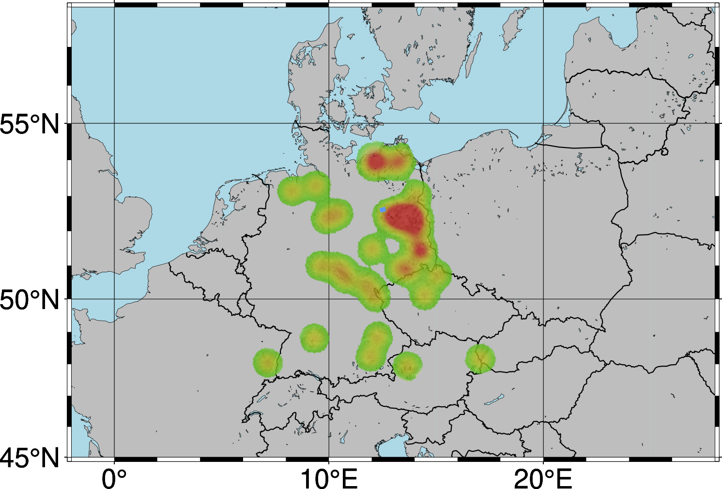
Event Location
Large meteor event on January 21st 2024 at ~00:33 UTC over Germany
Meteoroid-Event was reported online by 37 witnesses
IMO generated meteoroid trajectory based on these reports
The trajectory constrains initial search area for seismoacoustic recordings
Map modified from IMO-Event 423-2024
4

Slide 5
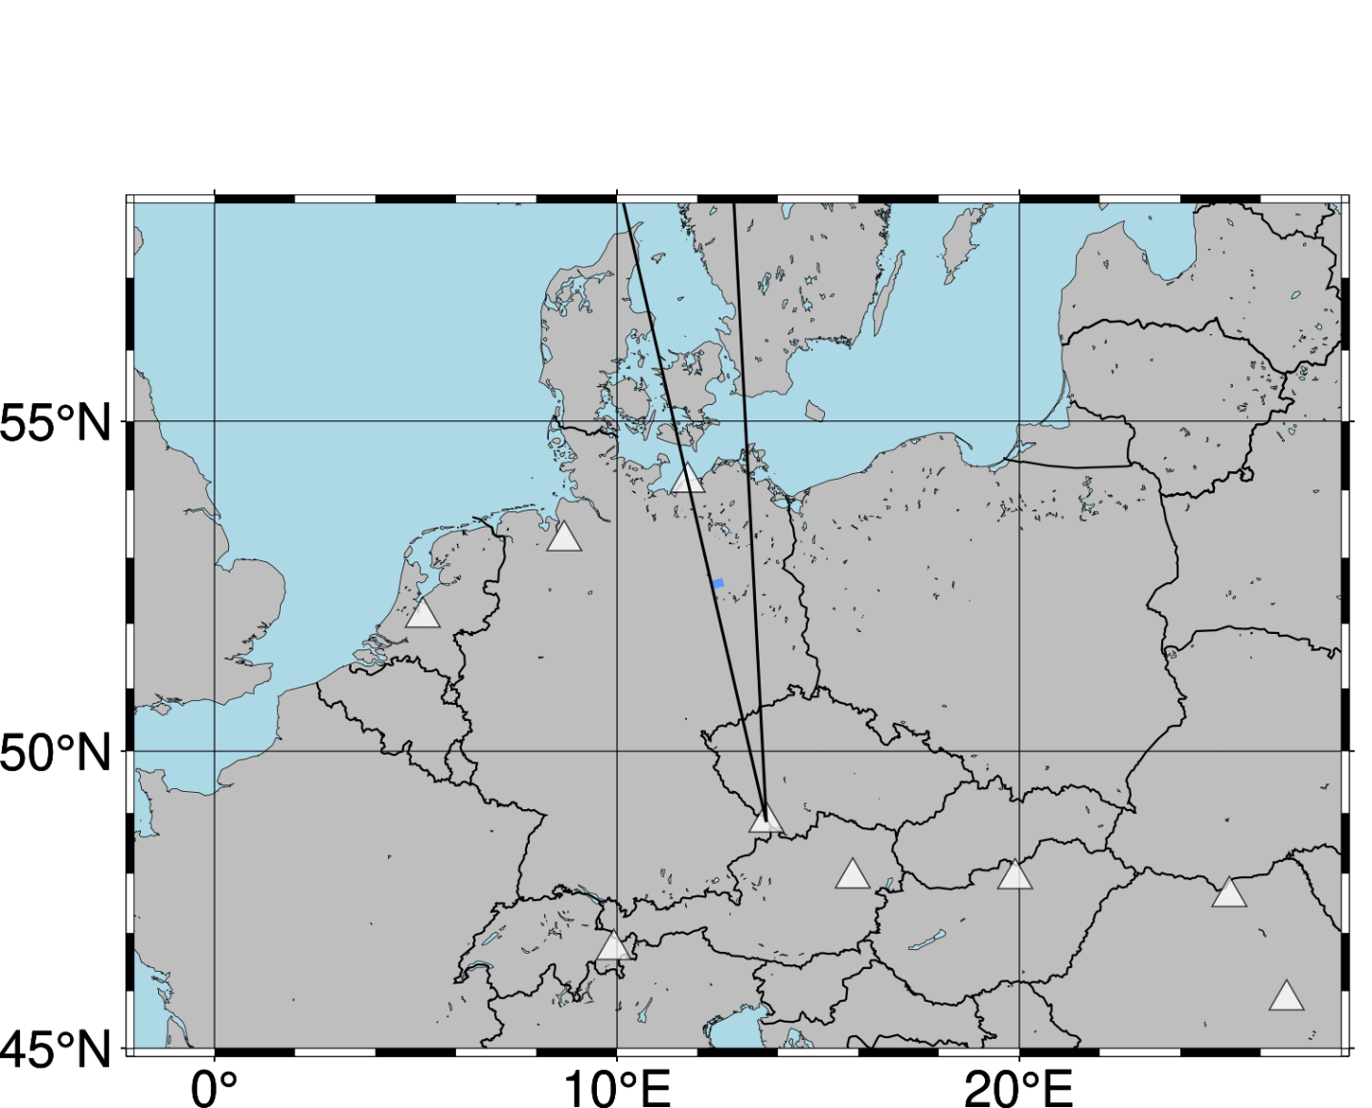
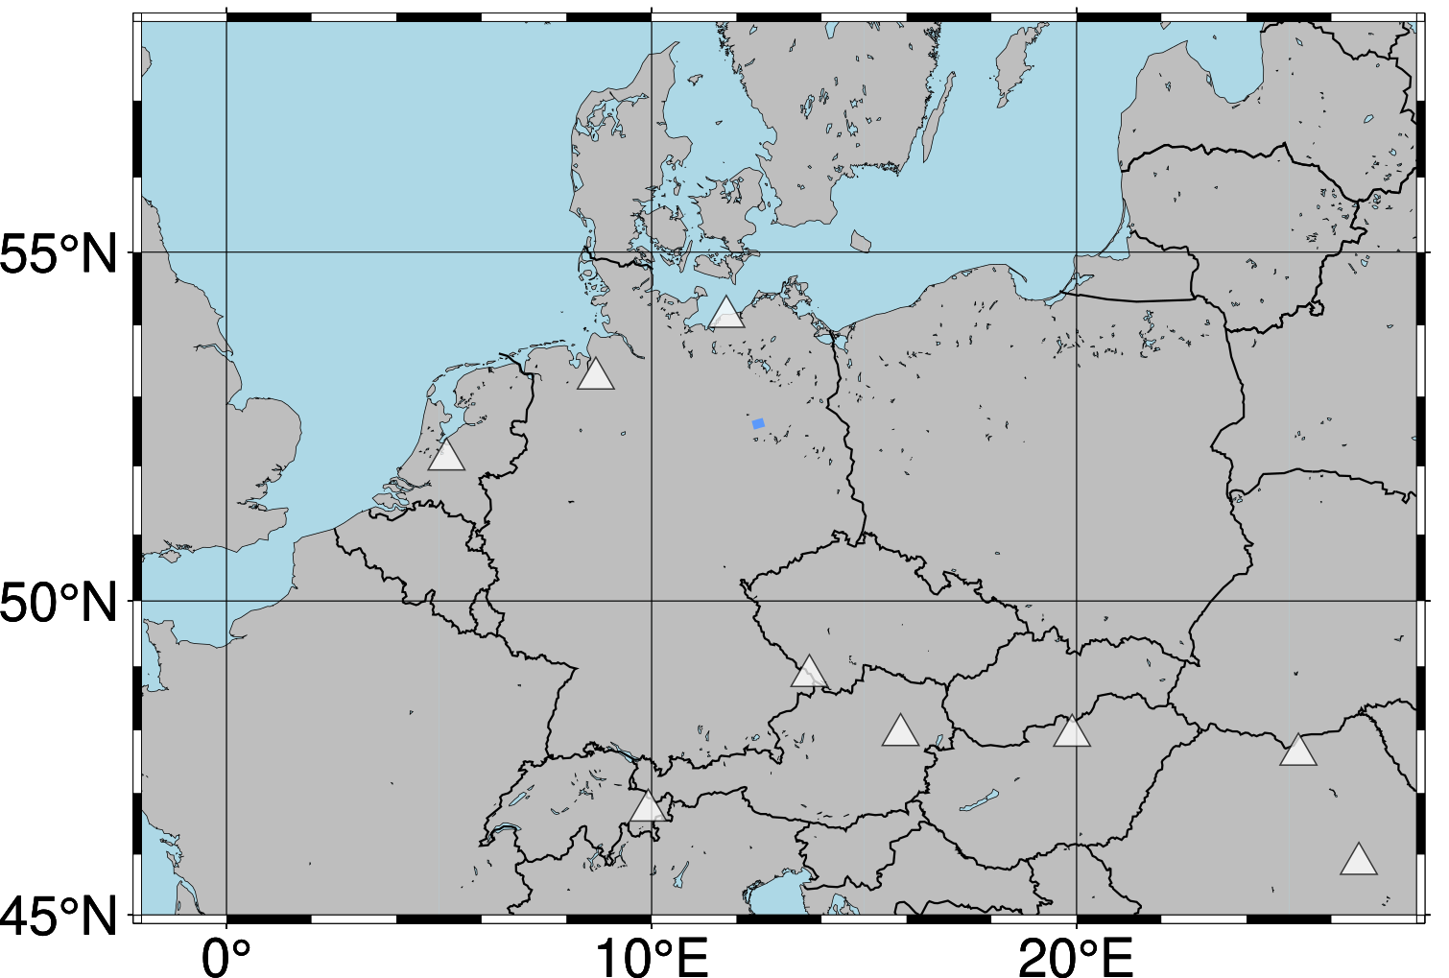
Infrasound Array Locations
9 infrasound arrays all over Europe
Infrasound arrays can be used for beamforming techniques
stacking improves SNR
time tracking of meteoroid trajectory
5

Slide 6
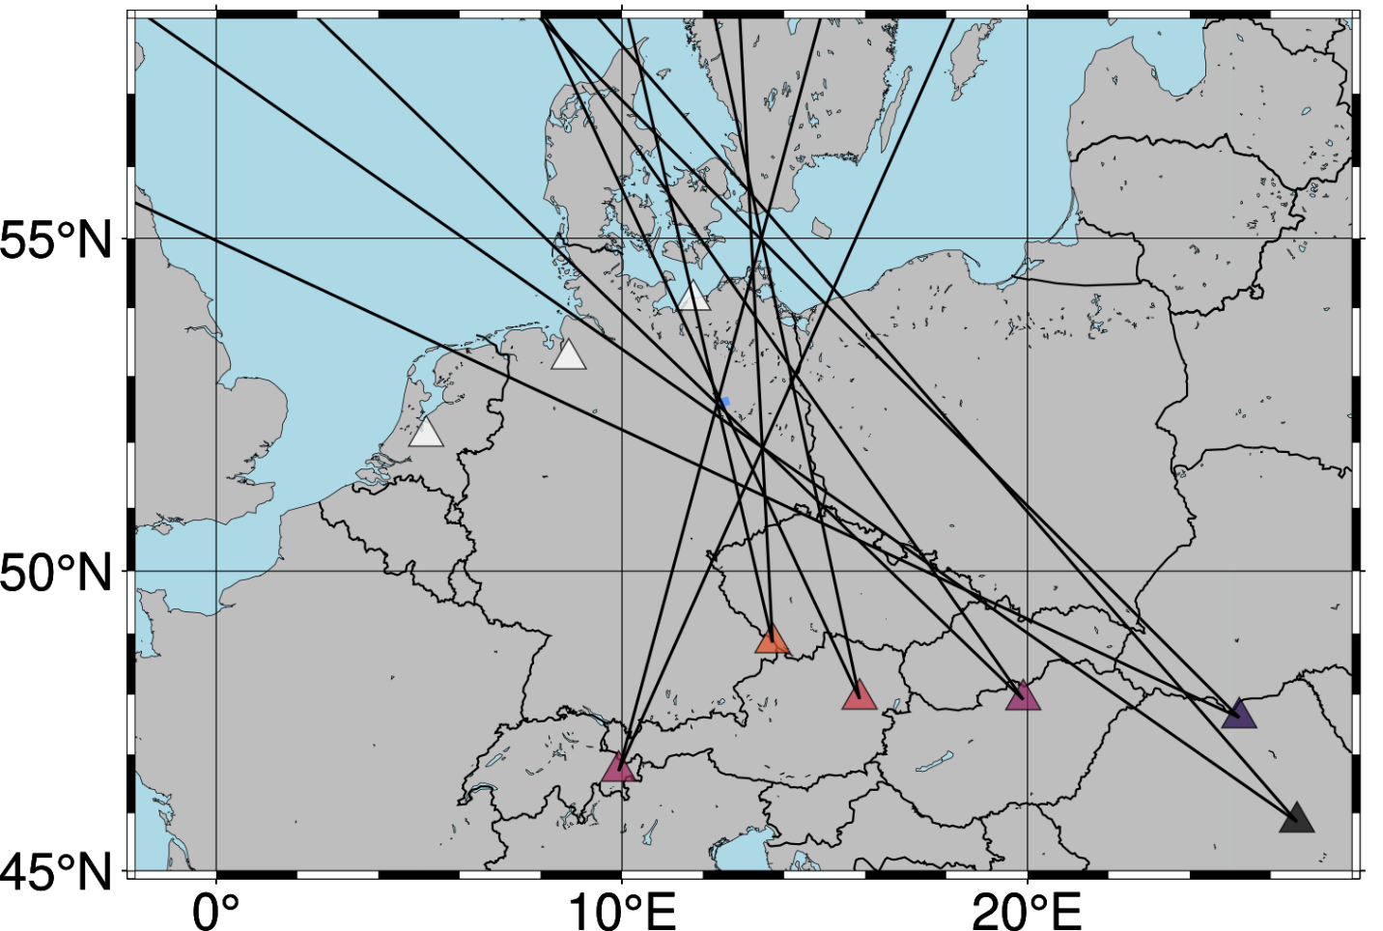
Infrasound Array Locations
Identified meteoroid signals at 6 out of 9 arrays
dominant wind direction SE
arrays without a signal are located downwind
Signals travel more than an hour to distant arrays
Crossing of beams can be used to find signal origin (meteoroid trajectory)
6

Slide 7
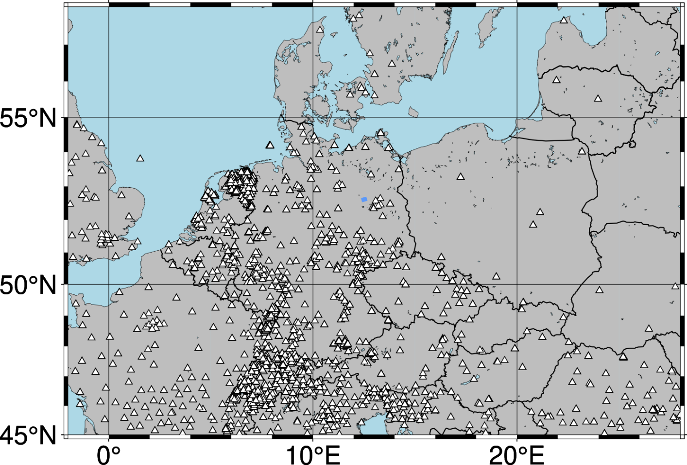
Seismic Station Locations
Roughly 1000 seismic stations in the map area
Single station observations can be used to reconstruct the trajectory
Highest information gain from nearest seismic stations
→ more detailed analysis of seismic recordings in target area
7

Slide 8
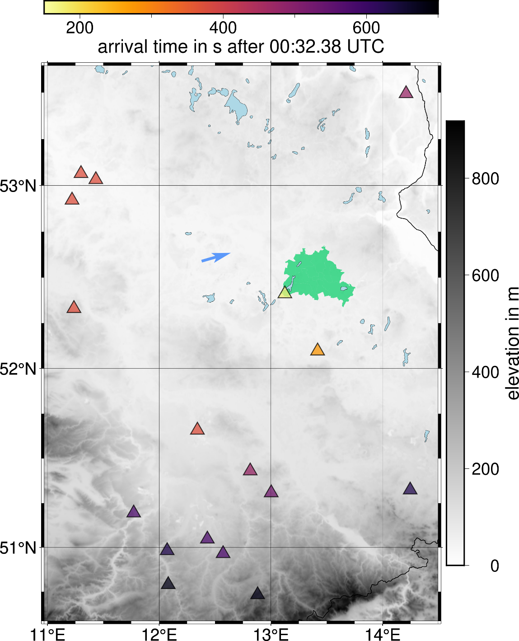
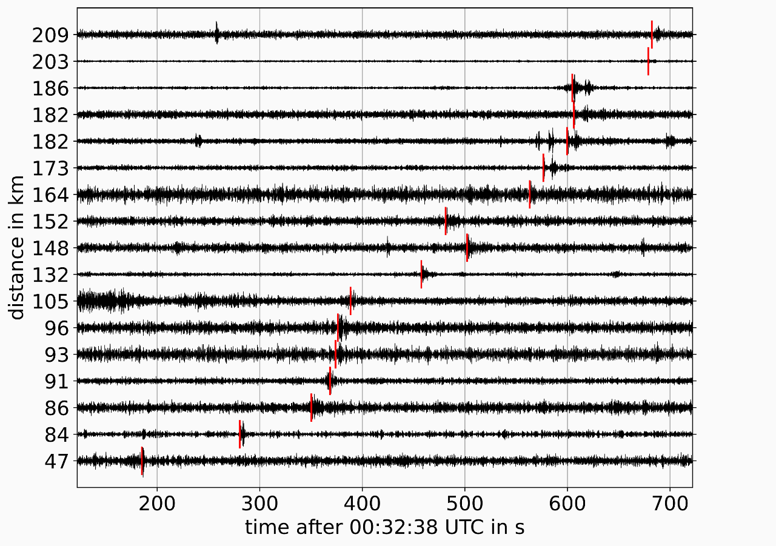
Seismic Station Locations
Identified arrivals at 17 seismic stations
distances >200 km
time delays >650 s
Berlin
8

Slide 9
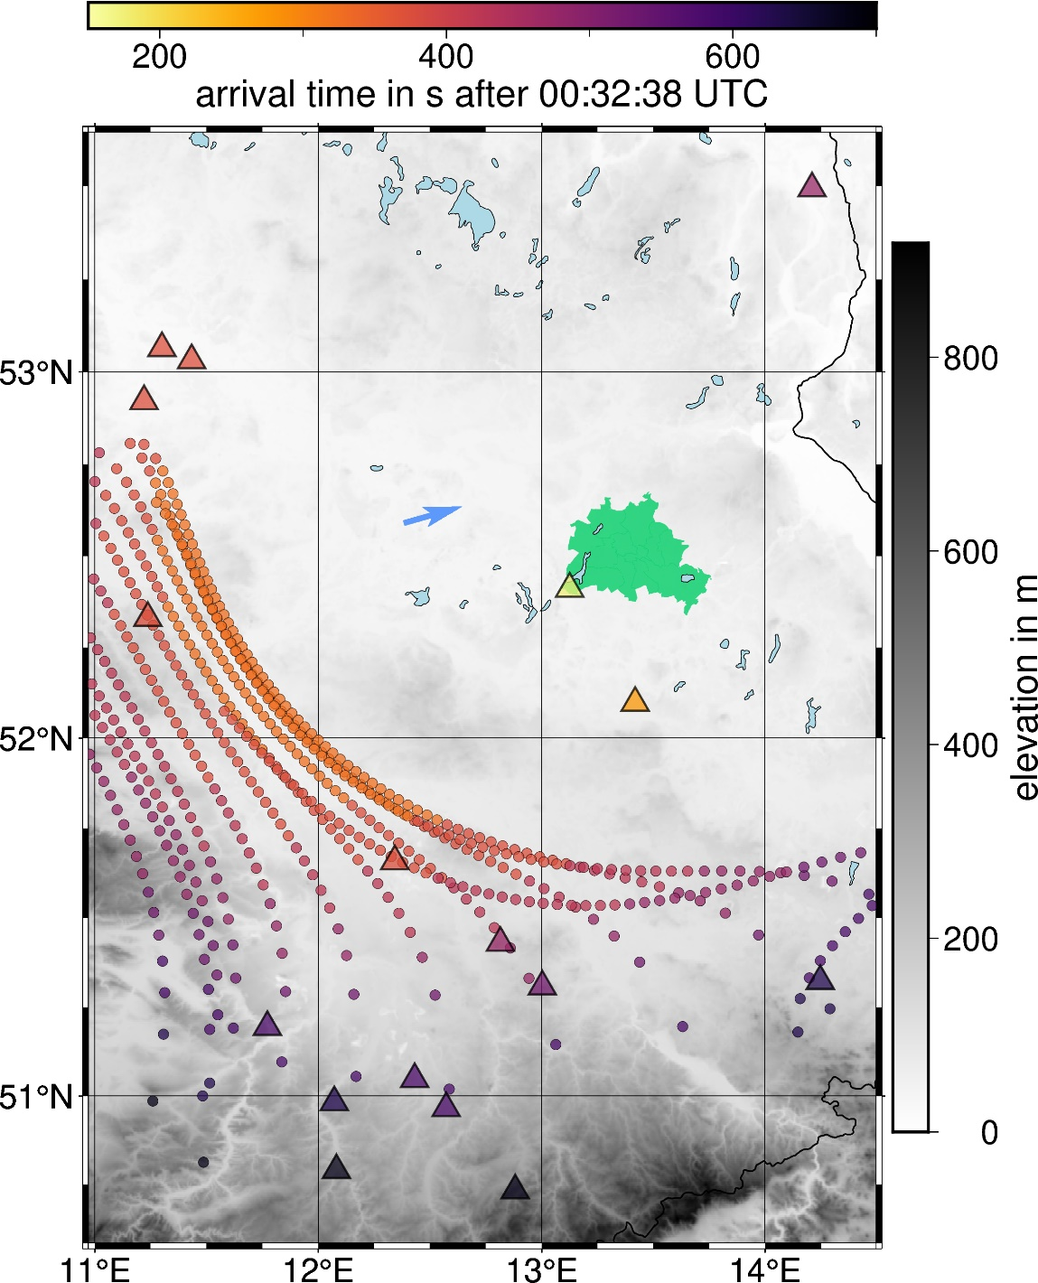
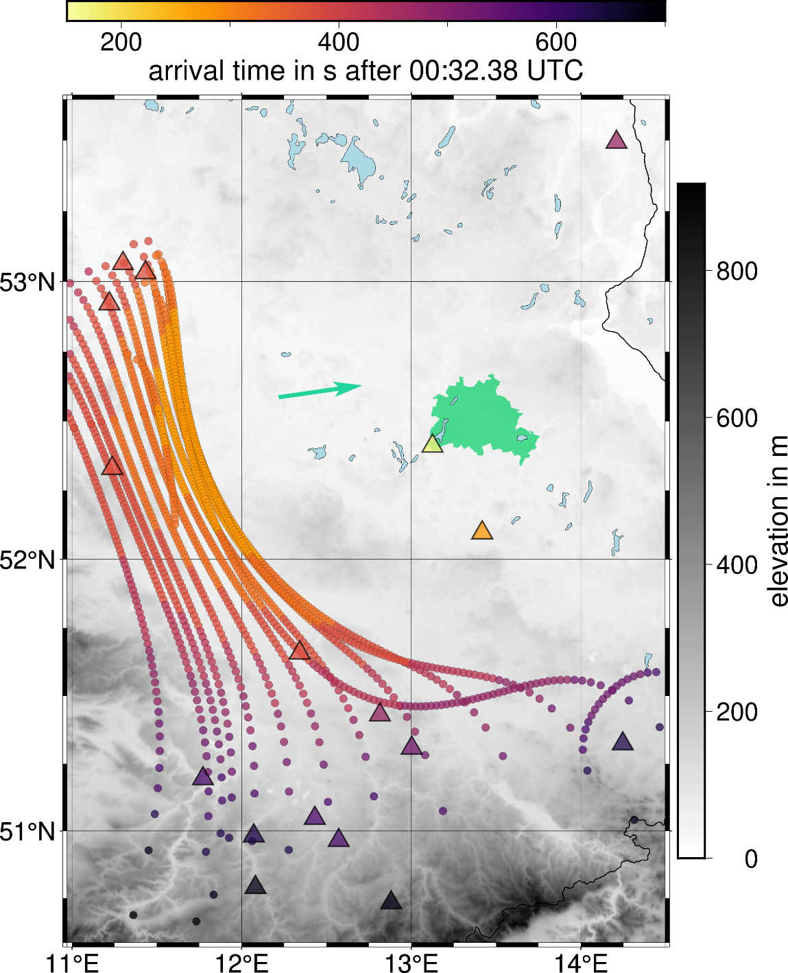
Direct Search Algorithm
Forwards modeling of acoustic rays propagating through Earth’s atmosphere with infraGA
Simulation of a Mach source
acts as a line source along the trajectory
Good match of arrival times at southern and western seismic stations
Arrival times in the northeast cannot be explained by a Mach source
9

Slide 10
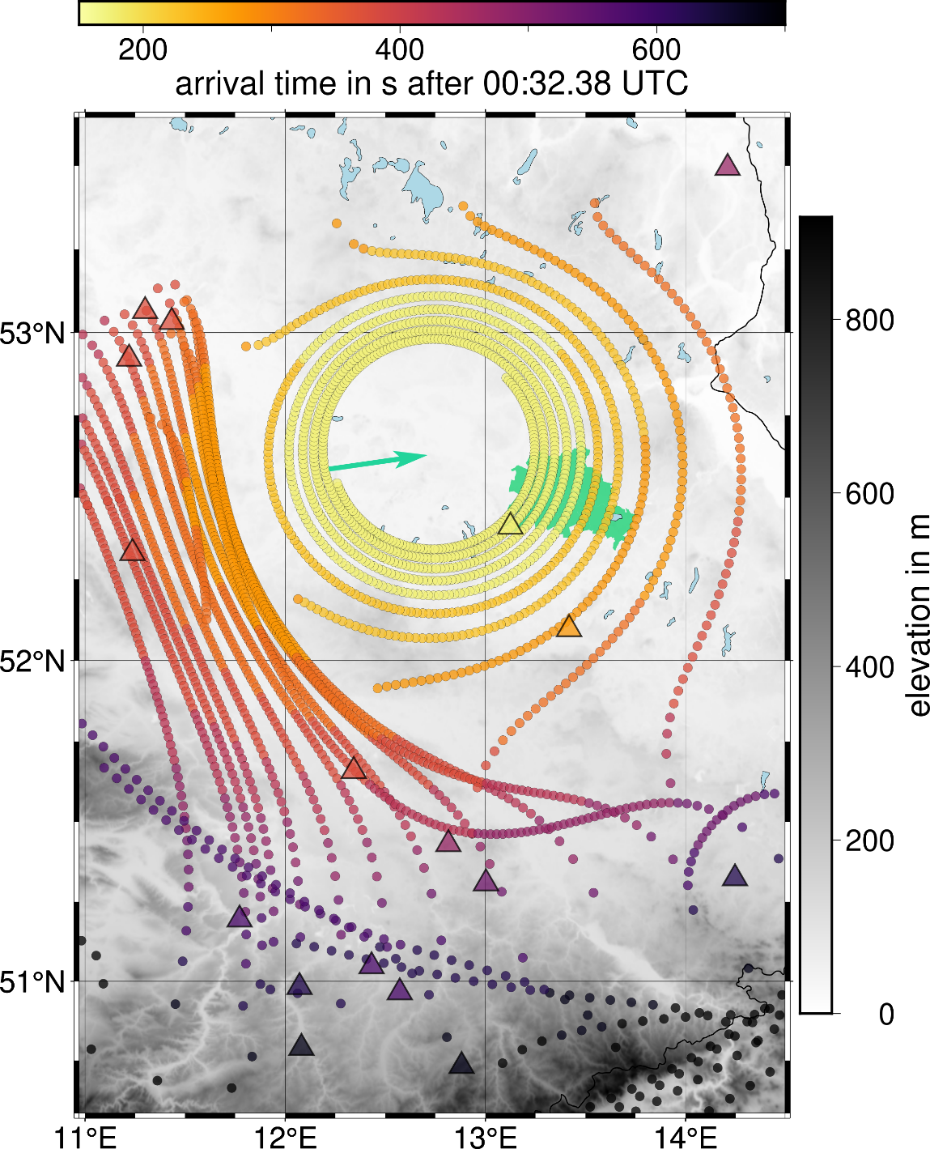
Direct Search Algorithm
Mach Cone source does not explain northeastern arrival times
Additional modeling of point sources along the end of the trajectory
fragmentation of the meteoroid
Combined source approach sufficiently explains all direct wave arrival times at seismic stations
10

Slide 11
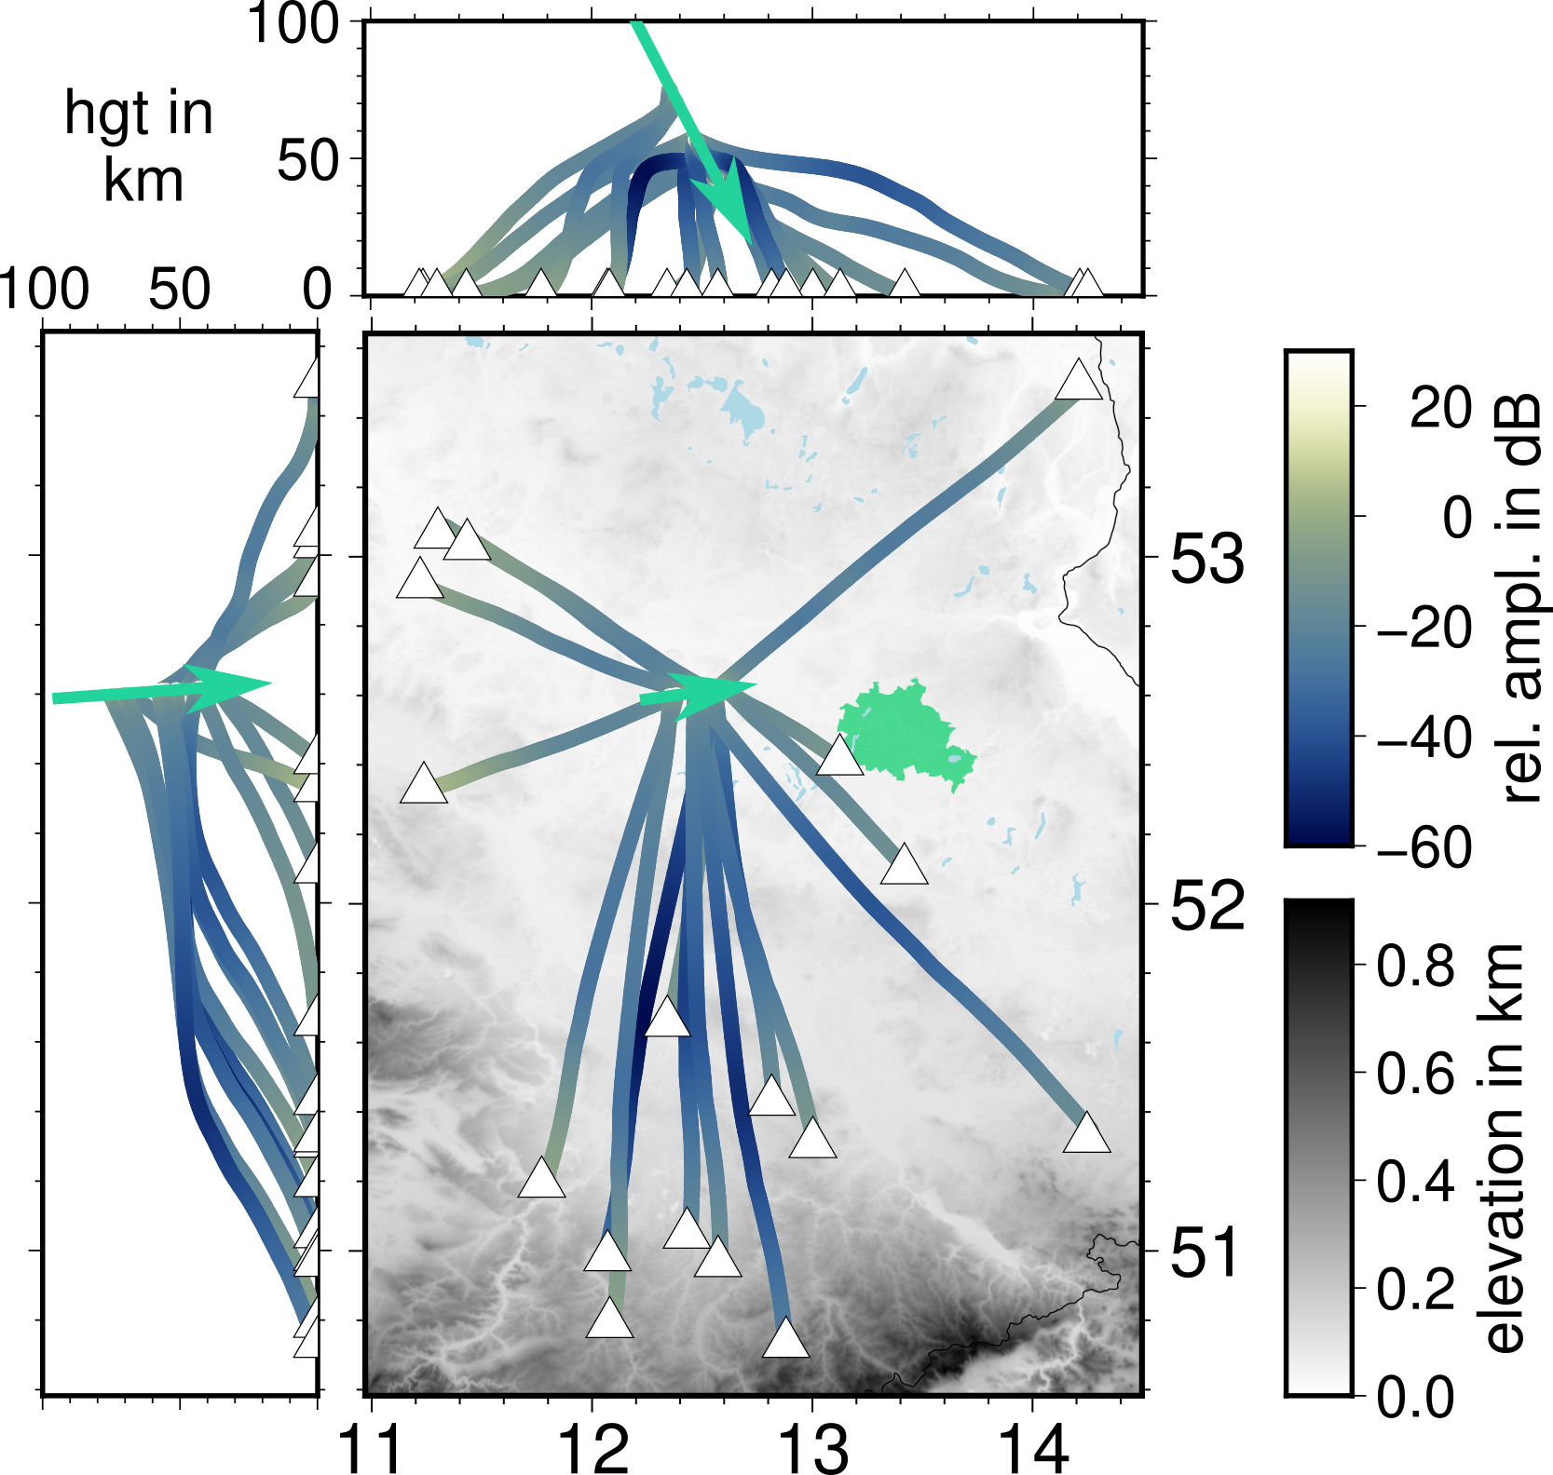
Direct Search Algorithm
height
in km
Realistic 3-D atmosphere velocity model
vertical bending of rays
Wind^{[1]} effects must be considered
horizontal bending
Random starting trajectory model
forwards propagation of rays towards stations
Update trajectory model
minimization of arrival time residuals yields best-fit trajectory
[1]: wind data from NCPA, Mississippi, https:github.com/chetzer-ncpa/ncpag2s-clc

Slide 12
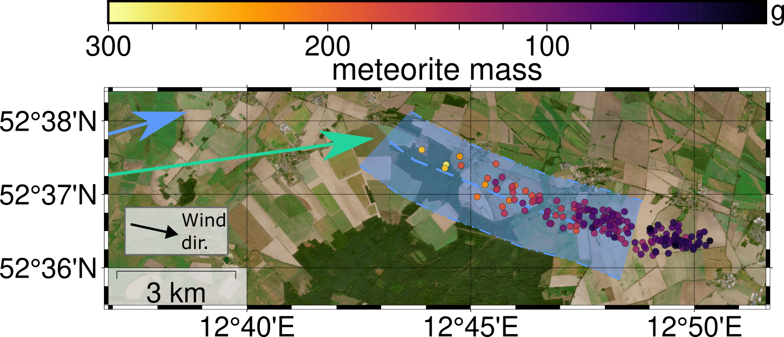
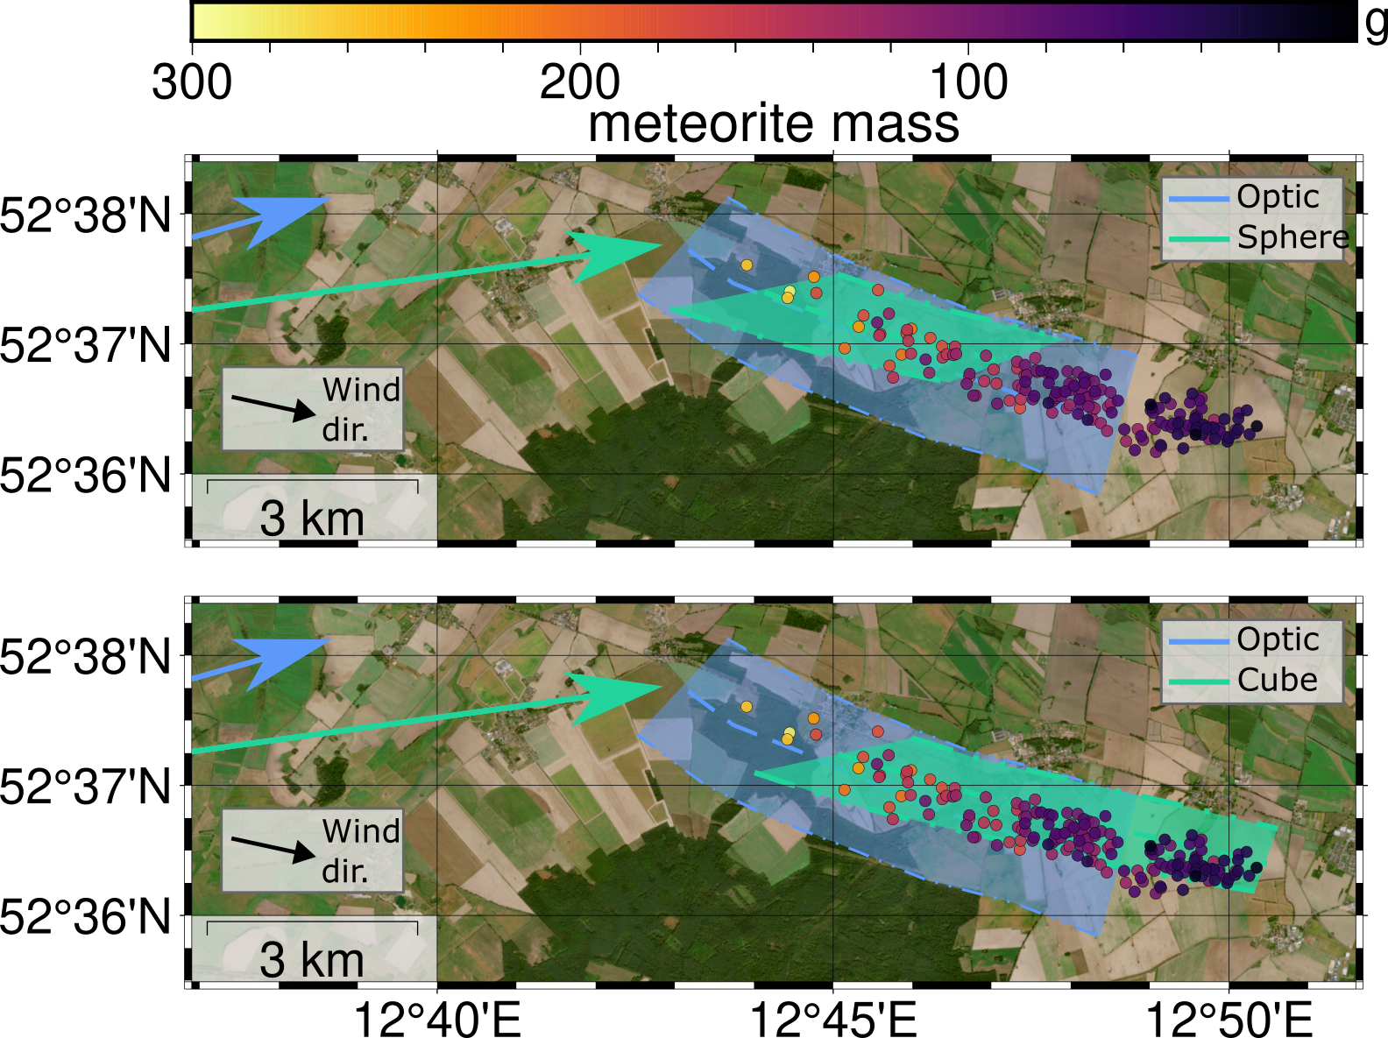
Strewn field estimation
Trajectories for optic and seismic observations are in agreement (~5 km apart)
Last 10 km of seismic trajectory are assumed to be meteorite generating
Simulation of spherical and cubic fragments
Meteorite locations:
Rendtel, J., et al. (2024). WGN, Journal of the International Meteor Organization, 52(2), 29-39.
12

Slide 13
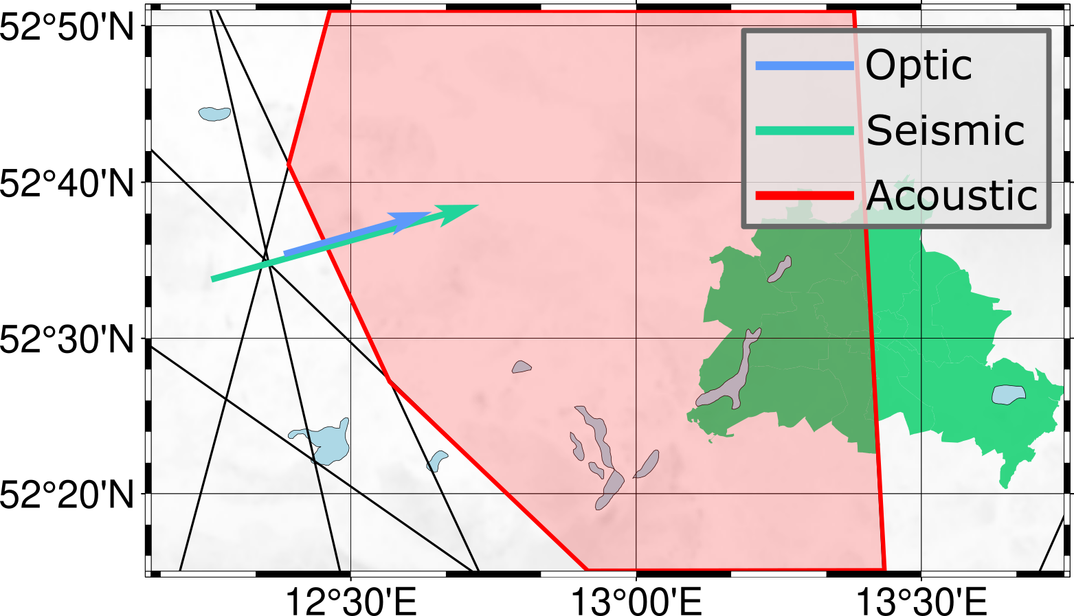
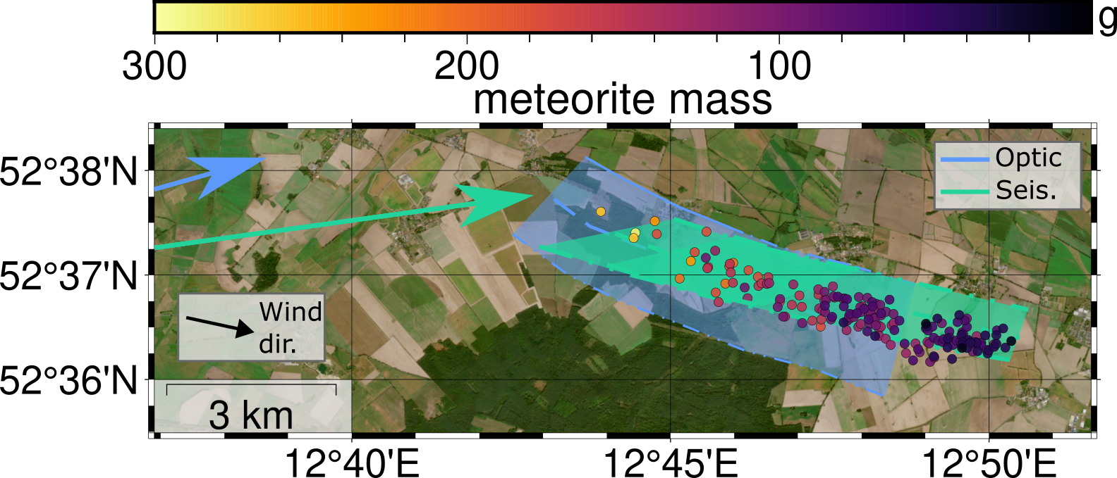
Conclusion
Infrasound data alone are not accurate enough in this case study
but help to pinpoint greater study area for seismic data
Seismic strewn field estimation are very close to true meteorite recovery locations
Completely independent seismoacoustic trajectory reconstruction and strewn field estimations can support future meteorite recovery expeditions
50 km
13

